Slide 1
Business organizations
Please get out your Vocabulary Assignment – due today!
TWIZ tomorrow on Chapter 7 ☺
Current Events resume today!

Slide 2
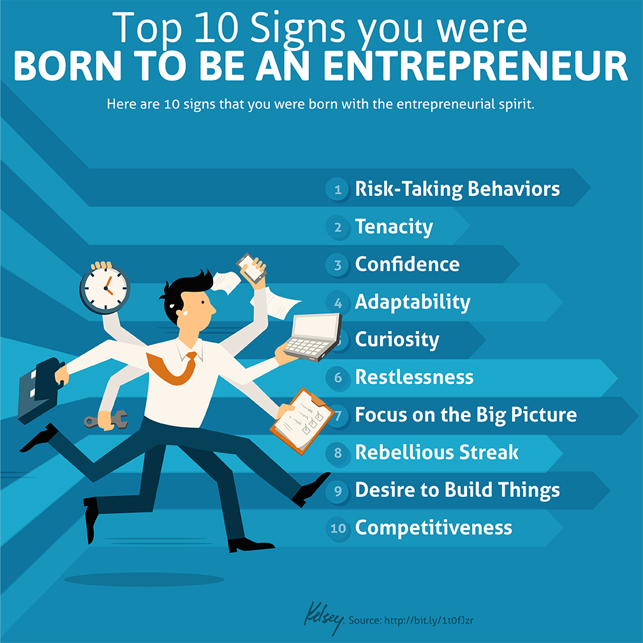
What is an entrepreneur?
An entrepreneur is a person who has the skill-set to successfully start up and manage a business and they possess these qualities…
  Seek out responsibility
  Are willing to take risks
  Believe in themselves
  Desire to reach their full potential
  Have high energy
  Look toward the future – are forward thinking
  Value achievement over money
  Maintain flexibility when they face a new challenge
  Committed to their goals

Slide 3

Some entrepreneurs think of it all…

Slide 4

Starting up a new business
Entrepreneurs have to make a lot of decisions when they start up a new business – including what type of business they intend to create.
A business organization is an establishment that is formed to carry out commercial enterprises – in other words, business organizations are firms. There are different types of business organizations:
  Sole proprietorships
  Partnerships
  Corporations, Mergers & Multinationals
  Franchises, Co-Ops, and Non-Profits

Slide 5
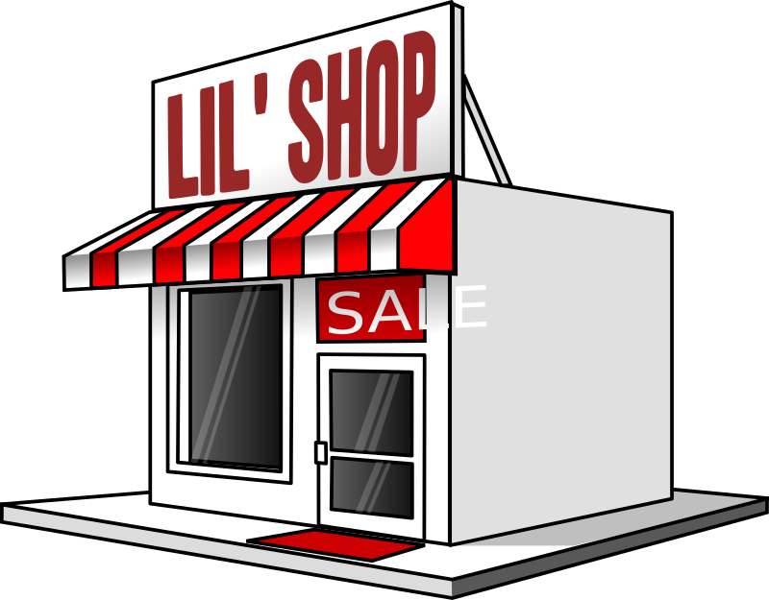
Sole proprietorship
Most common business organization; owned and operated by a single individual. (About 75% of all businesses in America)
The owner earns all the profits and deals with all of the firm’s debts.
Advantages | Disadvantages
Easy start-up (few government requirements – license, permit, and business name) | Total personal liability – legally bound to pay all debts, even if the business fails.
Few Regulations – least regulated form of business; does have to adhere to basic regulations (minimum wage, labor laws, etc.) | Limited access to resources – small businesses have to pay out of pocket to expand their businesses, this can be unattainable for some
Earn all the Profit | Lack of permanence – the owner dies, there may not be anyone to carry on the business
Total control
Easy to close the business

Slide 6
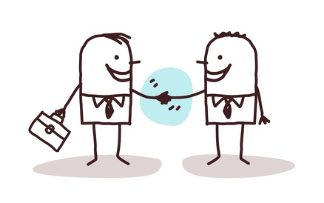
partnerships
A business organization owned by two or more people. (7% of businesses in America)
There are three categories: general, limited, and limited liability partnerships.
General Partnership | Limited Partnership | Limited Liability
Most common type | Only one partner is required to be the general partner. | Referred to as LLPs; new type of partnerships
Partners share the liability and responsibility equally. | Only one partner assumes the liability and responsibility. | All partners are limited partners except when it comes to their personal liability.
Examples: doctors’ practice, law firm, accounting firm, etc. | Limited partners can only lose their initial investment. | Not all businesses can register as an LLP.
 | Main advantage is control; drawback is extent of liability. | Most states allows professionals like attorneys or doctors to create LLPs.

Slide 7

partnerships
Partnerships are easy to start-up, allow for shared decision making opportunities, allow for specialization to occur and allow for partners to pool their assets and wealth.
Disadvantages include the fact that liability is unlimited, especially for the general partner, and there is a great potential for conflict.

Slide 8
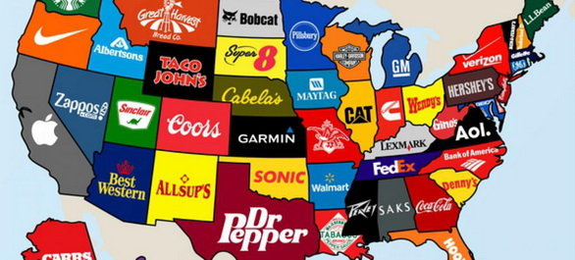
Corporations
A corporation is a legal entity that is owned by individual stockholders – each of who have limited liability for a firm’s debts.
Stockholders are people who own stock (certificate of ownership in a company).
Corporations exist independently of the individual owner(s) – but they operate like an individual. They must pay taxes, engage in trade and business, make contracts, sue other parties or businesses and get sued.
Only 20% of all businesses in America are corporations but they sell 90% of all products sold in our nation.

Slide 9

corporations
There are advantages and disadvantages to the owner and stockholders of corporations/incorporations
Advantages | Disadvantages
Limited liability for the owners | Expense and difficulty to start-up
Easy to transfer ownership | Double taxation – corporations pay dividends to their stockholders and increased income (profit) taxes
Ability to attract capital | Potential loss of control by the founders – stockholder take over
Long-life business venture | More legal requirements and regulations
Horizontal Merger- When two or more firms in the same industry join together.
Vertical Merger- When two or more firms join that are in different production stages.
Conglomerates- When large firms buy out other firms.

Slide 10
Squatty potty update

Slide 11
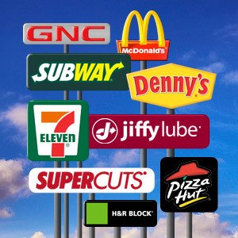
franchises
A business franchise is a semi-independent business that pays fees to a parent company. In return, the business is granted the exclusive right to sell a certain product or service in given area.
  Franchises are good because the franchisers (owners) provide management and training, they provide the product, it’s nationally recognized product, and they advertise for you.
  Drawbacks include high franchising fees (called royalties), strict standards, purchasing restrictions, and limited product line.

Slide 12

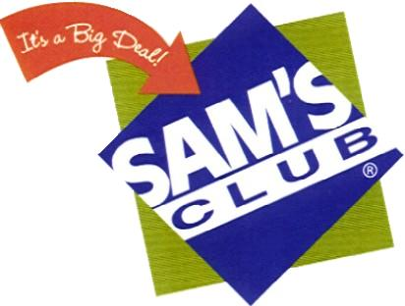
Cooperative organizations
Often called a “co-op” – owned by lots of individuals for their shared benefits.
There are consumer co-ops that sell merchandise to members at discounted prices (examples: Sam’s or Costco, Disney Movie Club, New Leaf Market)
Service co-ops provide a service rather than products – services might include babysitting club, legal groups, health care services, etc.
Finally producer co-ops are agricultural groups that focuses on growing their crops or raising living stock.

Slide 13


Non-profit organizations
Some groups function like a business organization but they do not operate for the sole purpose of generating a profit. Instead, they usually benefit society.
  Red Cross
  Big Brother/Sisters
  Schools
  Hospitals
  Religious Institutions
  YMCAs
These groups are often exempt from income taxes because they do not bring in a profit.
Some non-profits work to provide professional support for certain professions – union groups, business associations, and trade groups are all non-profits.

Slide 14
Not every idea has the potential to spawn a business

